Slide 1
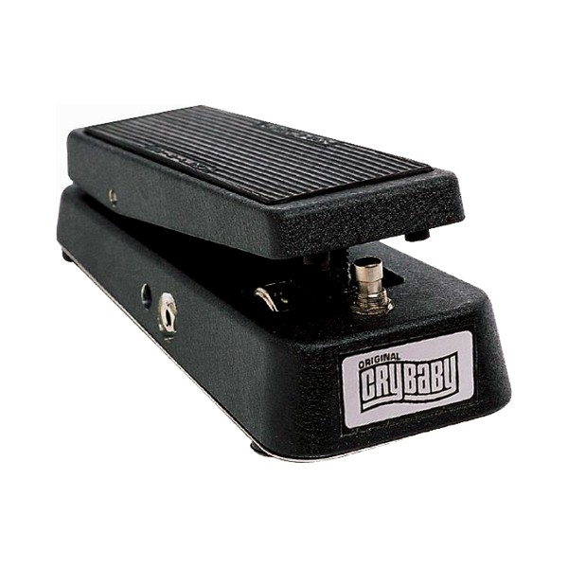
Wah-wah

Slide 2
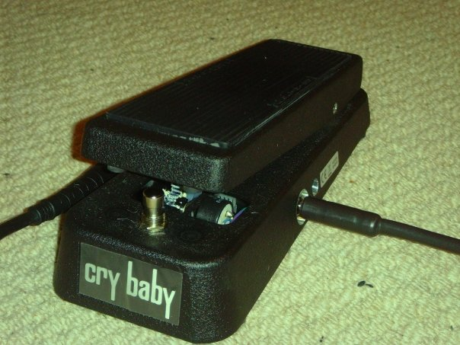
Background
Originally developed by jazz trumpeters using mutes
Guitar effect since Jimi Hendrix popularised Vox Crybaby pedal in late 1960s
Wah-wah pedal
Resonant (high-Q) filter
Pedal controls variable centre frequency
Knob controls dry/wet mix
Original GCB95 Cry Baby Wah

Slide 3
Block diagram
x[n]
y[n]
+
1-Mix
Mix
Bandpass or peaking filter with variable center frequency
Variable Mixing

Slide 4
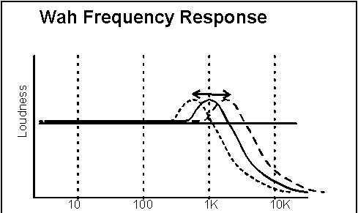
Wah-wah resembles human vocalisation
Spectral characteristics of phonemes [u],[a]
Vocal folds are harmonic source filtered by formants depending on shape of mouth
[u] vowel: first formant ~350 Hz
[a] vowel: first formant ~700 Hz
[u] to [a] articulation produces modulated sound
1st formant moves up in frequency
[a] ‘ah’ first formant in range 700-1200Hz
Matches range of resonant peak in wah-wah circuit
Pedal range covers frequencies where first 2 formants overlap
Missing second formant
Only one resonant peak in wah-wah circuit
Electro-Harmonix “Talking Pedal” uses two peaks

Slide 5
Varieties of wah-wah effects
Resonant filter
lowpass, bandpass or peaking filter
Variable centre frequency
can vary from near 0 to fs/2
In practice, varies across midrange only
Small bandwidth→ high Q
Standard wah-wah
Centre frequency manually controlled by pedal
Auto-wah, centre frequency controlled by
LFO, frequency usually 1-2 Hz OR,
Envelope of input signal
Tremolo-wah
also amplitude variations
magnitude 12 dB (G_{c} ~ 20) at ω_{c}=π/2
Magnitude Response of Resonant lowpass filter

Slide 6



Auto-wah - LFO
One auto-wah effect uses low-frequency oscillator
LFO controls filter’s centre frequency
Similar parameters to other LFO effects:
Sweep rate
Sweep width
Minimum frequency
W
fc
fmin
Time

Slide 7
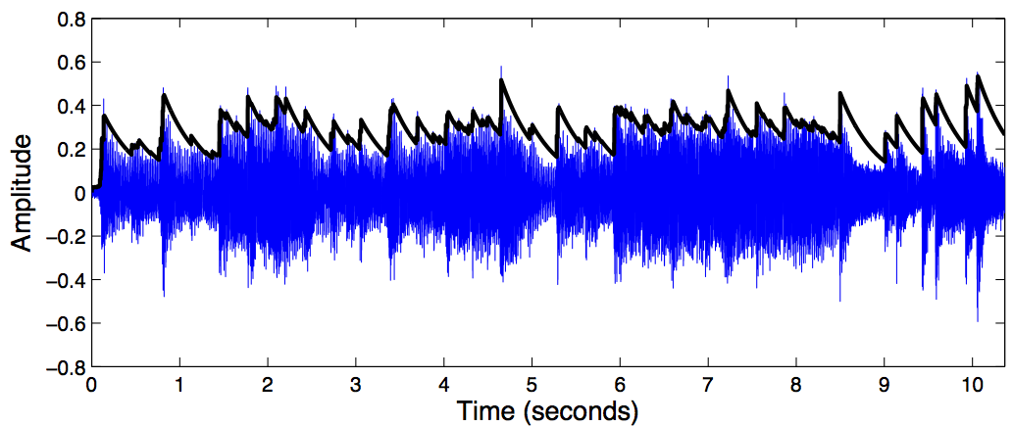

Auto-wah – envelope follower
Can also refer to envelope follower wah effect
Centre frequency scales with signal envelope
Envelope is local average signal level
Envelope characterised by attack and decay times
How fast does it respond to increasing and decreasing signal?
Usually, attack time << decay time
Other parameters:
Minimum frequency f_{min}
Sensitivity S

Slide 8
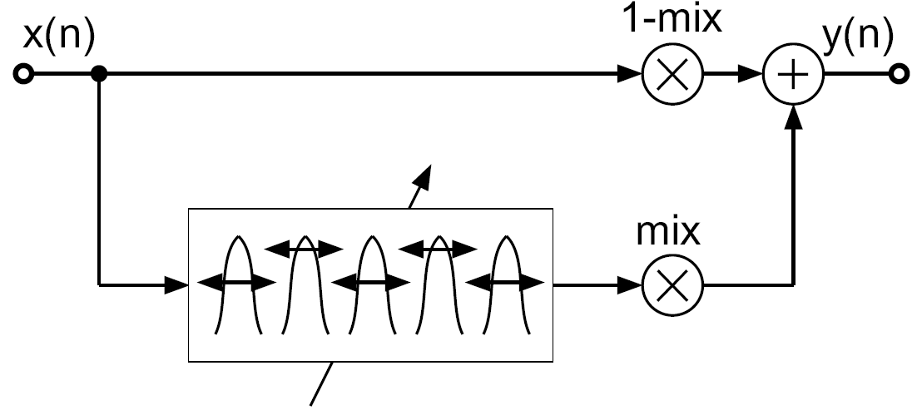
M-fold wah-wah
Replace unit delay in resonant bandpass filter by M tap delay
M bandpass filters spread over entire spectrum
Simultaneously change their center frequency
M-fold wah-wah with white noise input
Periodic enhancement of output spectrum

